Slide 1
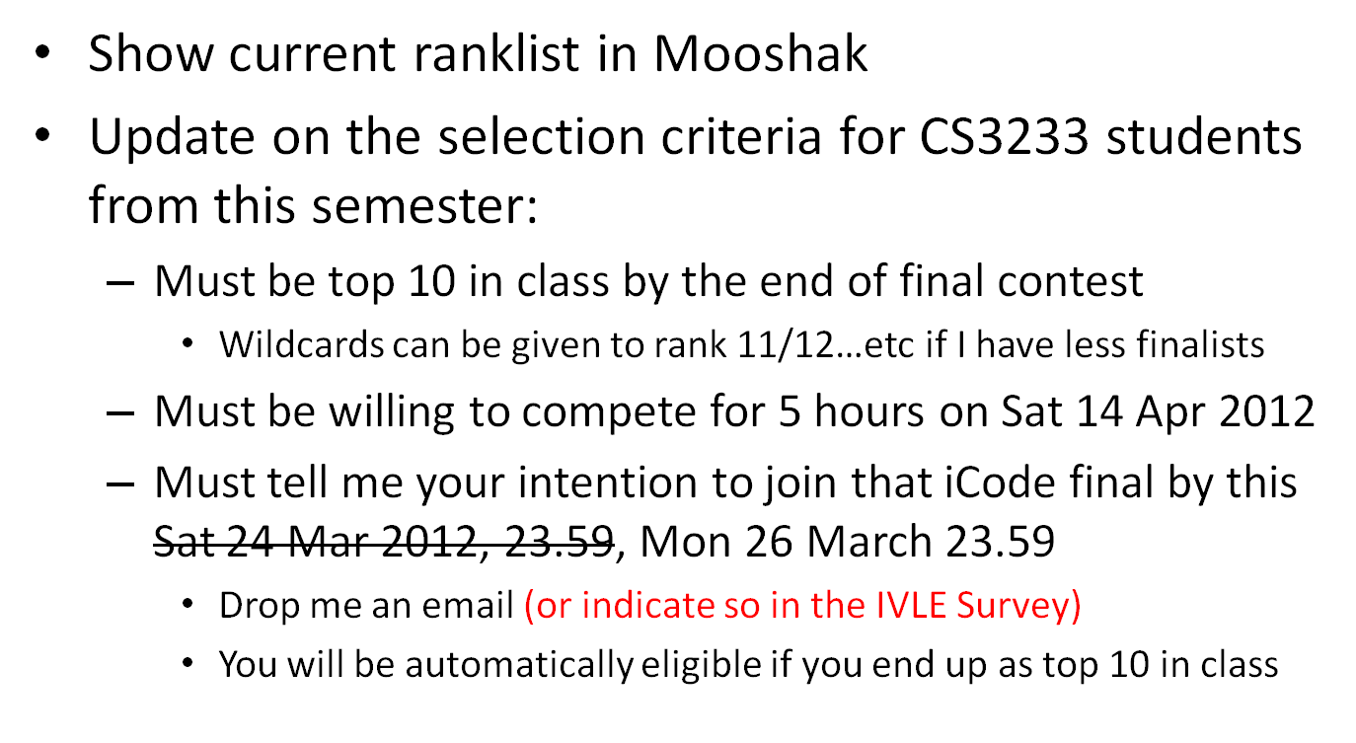
Update on iCode 2012
CS3233 - Competitive Programming,
Steven Halim, SoC, NUS

Slide 2
Achievement 17 ☺
17**. Bookworm: Subjective title for student who diligently study and review CP book by the end of Week13, awarded by Steven
  Starting from last week, one star (1%) is given to those who has achieved at least full score (1.0) for book review homework at least TWICE (6 reviews so far)
    Huang Da 5x, **
    Pang Yan Han 4x, **
    Pan Zhenyang 3x, *
    Shailendra Khemka 1x (almost one star)
  There are three more chapters: 6, 7, 8 to review
CS3233 - Competitive Programming,
Steven Halim, SoC, NUS

Slide 3
Achievement 18 ☺
18**. Active in class: Subjective title for student who participated well during various class activities (answering in-lecture questions, asking questions, consultations, etc), awarded by Steven
  As with last week (Maths lecture), one star (1%) is given for those who are willing to shout out their answers during
  in-class pop quizzes (raise your hand first btw!)
  So far (including Week 10 String Lecture):
    Shailendra Khemka **, Pang Yan Han **
    Le Viet Tien *, Nguyen Phi Long *, Tan Desmond *, Tay Wenbin *, John Goh *, Yang Mansheng *, Ngo The Trung *, Zhou Yiming *, Lim Zhi Qin *
CS3233 - Competitive Programming,
Steven Halim, SoC, NUS

Slide 4
Need Your Help/Feedback
Need to submit visualization paper to IOI conference by 31 March 2012
Need user (that is, all of you) feedbacks
Will set up CS3233 IVLE Survey (to be announced soon)
  Worth 2.5% :O, using Week 13/HW12 marks
  Therefore, on Week13/reading week,
  you don’t need to do such survey anymore
Please fill in the survey by Mon 26 March 23.59
  Need to compile the data ASAP
CS3233 - Competitive Programming,
Steven Halim, SoC, NUS

Slide 5
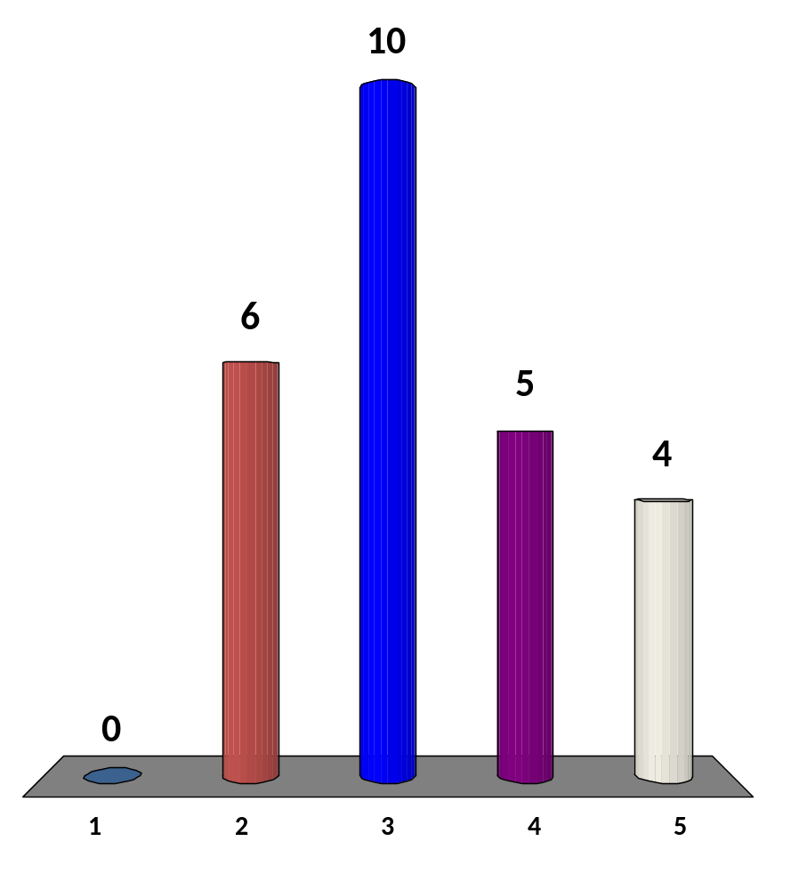
Which programming language is the best for processing strings?
C
C++
Java
Perl (eh what is this?)
It depends…
Being multilingual is good
18 of 120
CS3233 - Competitive Programming,
Steven Halim, SoC, NUS
Notes:
The best answer is “it depends”

Slide 6
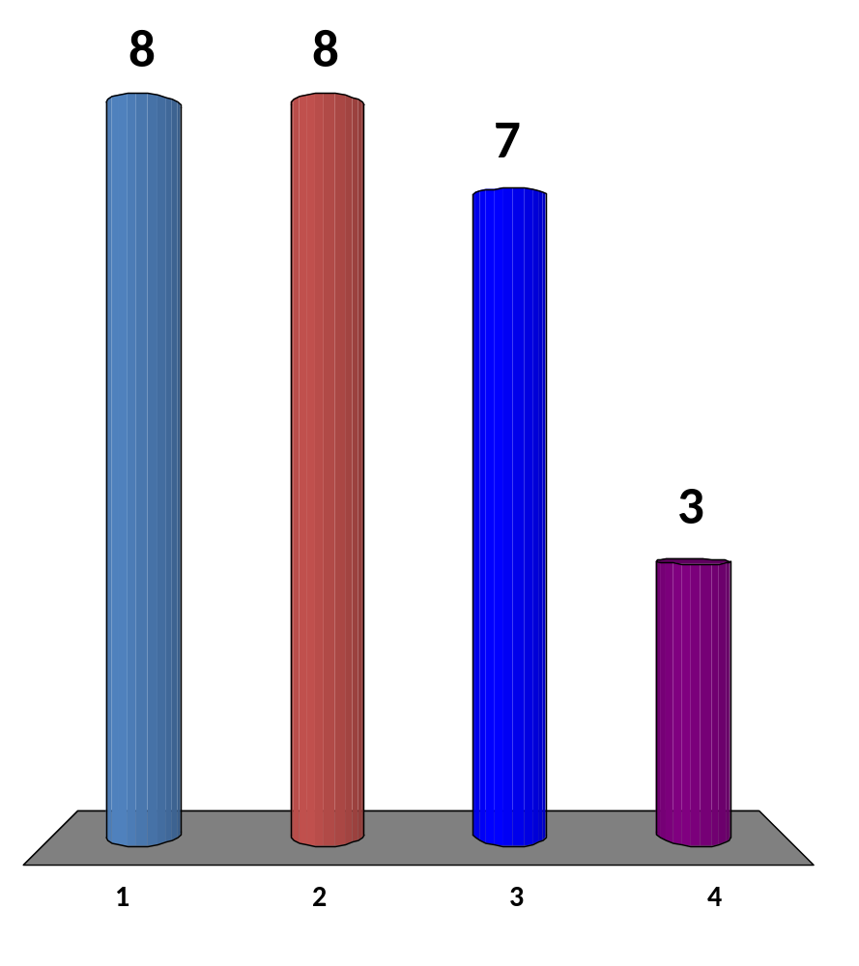
Quick Survey
I know all those tricks ☺
I learned at least 1 trick
I learned 2-3 tricks…
Wow… I am impressed with all these cool stuffs
26 of 120
CS3233 - Competitive Programming,
Steven Halim, SoC, NUS

Slide 7
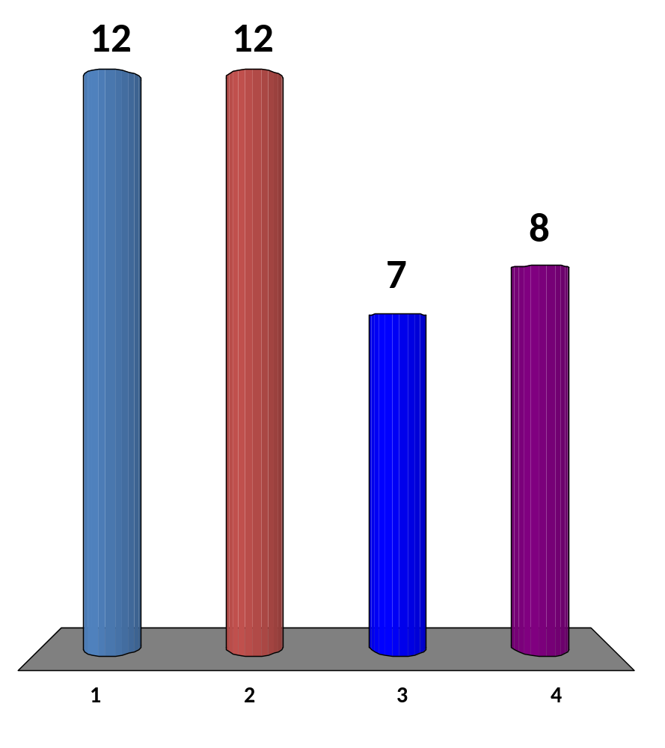
I...
Have never heard of this data structure before...
Am aware of this data structure but never code it before
Am aware that coding this data structure is difficult
Think this data structure is easy to implement
In Competitive Programming, at least you need to understand how to USE a given template code. You can still solve SA problem without 100% understanding on how SA works, but… this is not ideal if the problem is harder
23 of 120
CS3233 - Competitive Programming,
Steven Halim, SoC, NUS
Notes:
Majority no 1
No one select 4

Slide 8
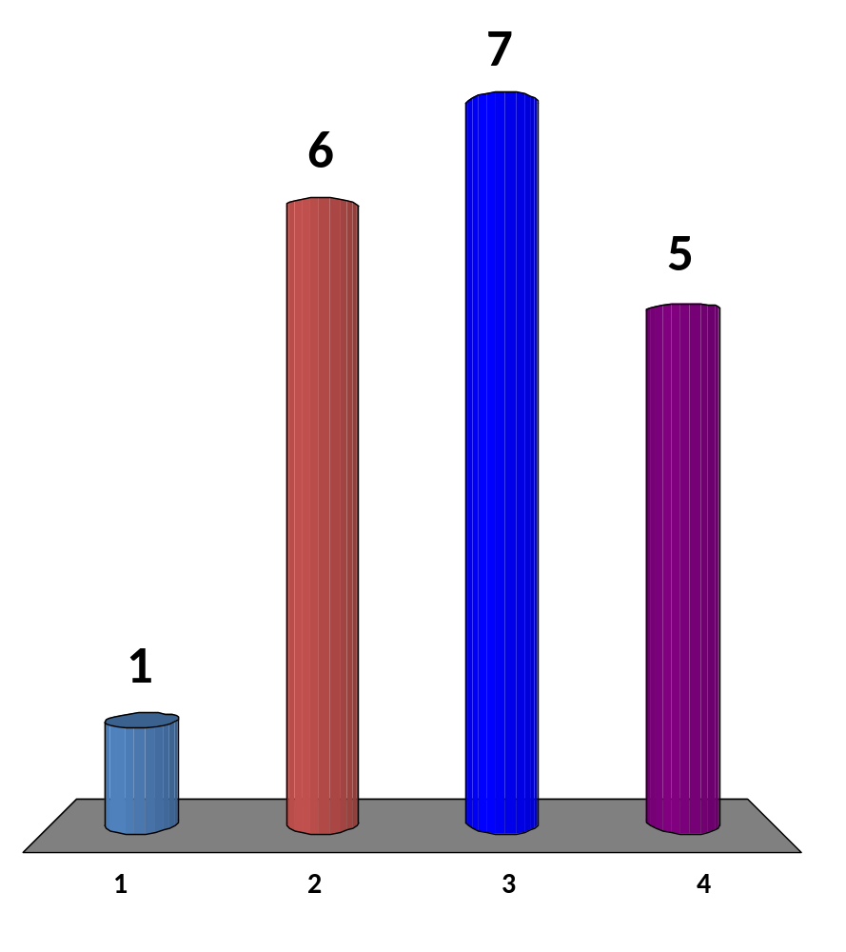
Check Point 1
Tell me your level of understanding so far!
I only understand the concept of suffix of string
I understand the concept of suffix and suffix trie
I understand that suffix tree is the compressed form of suffix trie and its terminologies (i.e. path label, terminating vertex)
On top of that, I also understand the various applications of suffix tree
19 of 120
CS3233 - Competitive Programming,
Steven Halim, SoC, NUS

Slide 9
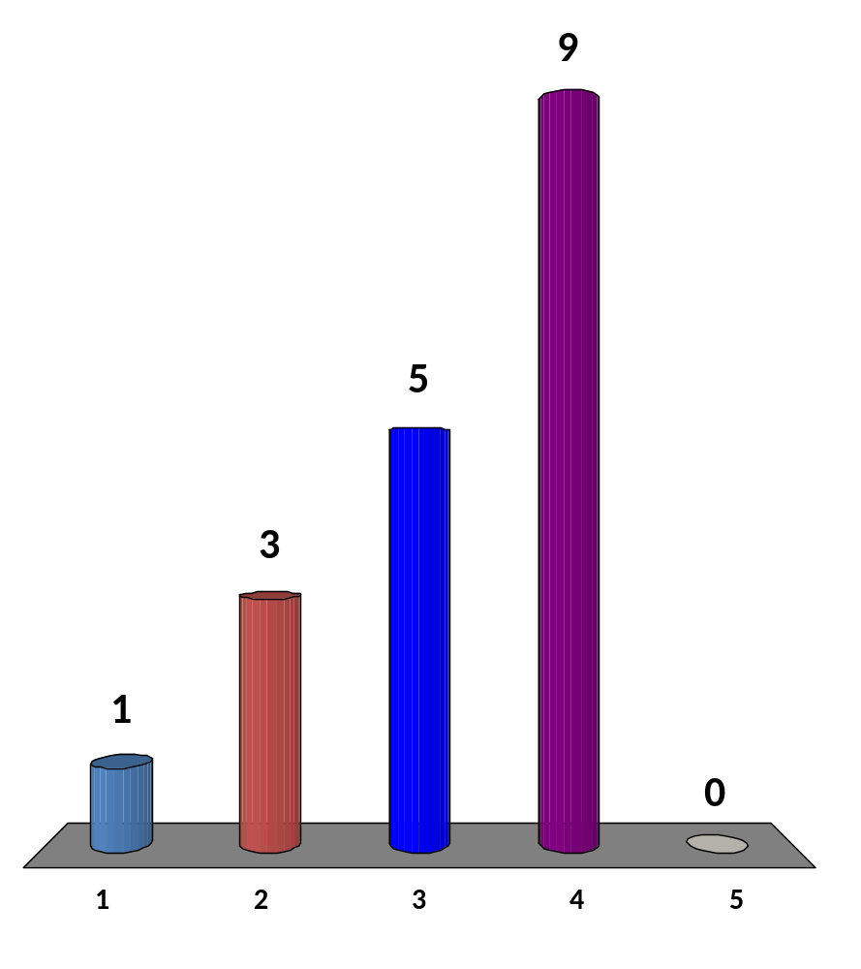
Check Point 2
Tell me your level of understanding so far!
I am aware that suffix array is just a permutation of n indices of sorted suffixes
I understand the similarities between suffix tree and array
I understand the idea on how to build suffix array in O(n² log n)
I understand the idea on how to build suffix array in O(n log² n) or O(n log n)
I can implement no 4 confidently
Must improve to at least level 4, then study my sample code
18 of 120
CS3233 - Competitive Programming,
Steven Halim, SoC, NUS

Slide 10
I skipped LCP last night
Read CP2 or the next two slides

Slide 11
LCP and Permuted LCP Example
T = 'GATAGACA'
Phi(i) = which suffix is behind this suffix in Suffix Array?
Lexicographic Order
Position Order
i | SA[i] | LCP[i] | Suffix | i | Phi[i] | PLCP[i] | Suffix
0 | 7 | 0 | A | 0 | 4 | 2 | GATAGACA
1 | 5 | 1 | ACA | 1 | 3 | 1 | ATAGACA
2 | 3 | 1 | AGACA | 2 | 0 | 0 | TAGACA
3 | 1 | 1 | ATAGACA | 3 | 5 | 1 | AGACA
4 | 6 | 0 | CA | 4 | 6 | 0 | GACA
5 | 4 | 0 | GACA | 5 | 7 | 1 | ACA
6 | 0 | 2 | GATAGACA | 6 | 1 | 0 | CA
7 | 2 | 0 | TAGACA | 7 | -1 | 0 | A
Phi[SA[2]] = SA[2-1]
Phi[3] = SA[1]
Phi[3] = 5
LCP[6] = PLCP[SA[6]] = PLCP[0] = 2
Check the LCP values if the Suffixes are sorted (Permuted LCP/PLCP)
CS3233 - Competitive Programming,
Steven Halim, SoC, NUS

Slide 12
Computing LCP
Compute Φ
  for i = 1 to n do Φ[SA[i]] = SA[i-1]
Compute PLCP
  L = 0
  for i = 0 to n-1 do
    while T[i+L] == T[Φ[i]+L] do L++
    PLCP[i] = L, L = max(L-1, 0)
Compute LCP
  for i = 1 to n do LCP[i] = PLCP[SA[i]]
PLCP theorem:
L is increased at most O(n) times
CS3233 - Competitive Programming,
Steven Halim, SoC, NUS

Slide 13
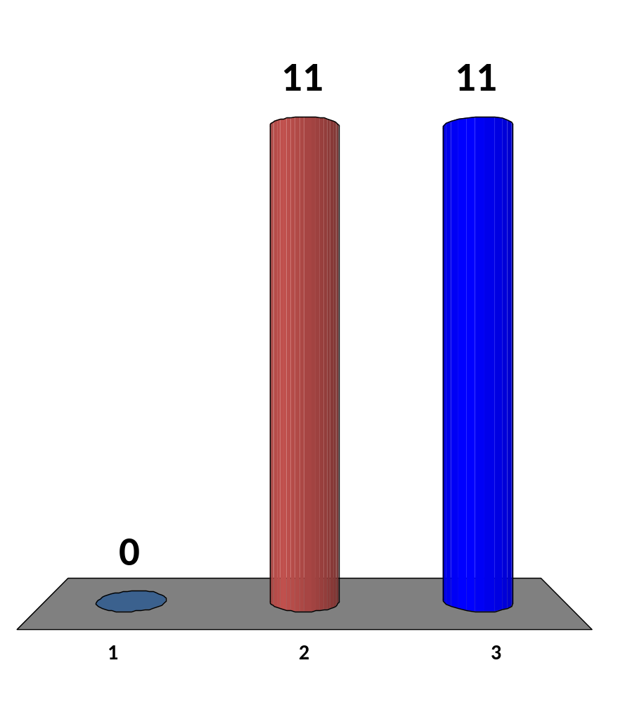
Check Point 3
Tell me your level of understanding so far!
I am OK, I have used SA several times ☺
I got the basic ideas, but will try solving some
SA-related problems
to see if I fully understand how it actually works
I am confused, this is a hard stuffs, I need consultation!!
PS, I will be in IIUM, Kuala Lumpur on 29 March-3 Apr
22 of 120
CS3233 - Competitive Programming,
Steven Halim, SoC, NUS

Slide 14
HW9 (due next Wed 11.59am!)
  Go to: http://uhunt.felix-halim.net/id/32900
  Solve UVa 760 – DNA Sequencing by using Suffix Array to obtain longest common substring of two DNAs
    The problem says subsequence, but actually it is looking for substring
  If you have solved these problems in the past, fine, we will count it as “homework part A done”
Solve problem C (Counting Subsequences) from today
  EMAIL to Phuong directly: u0906808@nus.edu.sg
Write a report on Chapter 6 (all… you will need some time to read it :O)
  Upload to IVLE Workbin, “CP2 Review”
Do CS3233 IVLE Survey esp about visualization project (will be set up soon)
Potential Achievements
  Chapter 5 diversity: Solve four starred problems from different category in chapter 5 by the end of Week10
  Still on track: Solve at least 10 weeks*4/week = 40 UVa problems by the end of Week 10 and also obtain Chapter 1-2-3-4-5 diversity

